Slide 1
Study Time Calculator
Hadassa Franklin (VC1A) - Dassiefranklin@gmail.com
Evie Barth (VC1B) - eviebarth18@gmail.com
Supervisor - Professor Katherine Chuang - chuang@sci.brooklyn.cuny.edu

Slide 2
Abstract
The goal of the Study Time Calculator is to help students calculate the amount of time they need to set aside for schoolwork and devise a weekly study schedule, enabling them to allocate their time wisely throughout the week and complete all their coursework. Students will input their classes hours, work hours and other relevant data such as extracurricular activities that they have upcoming. The program will then advise them on how much time they should have to allocate for schoolwork per week and assist them in finding suitable time slots in their schedules to complete it. This goal of this project aims to facilitate students in completing their coursework each week and discourage students from leaving everything until the last minute. The program outputs this data in a weekly schedule format, which we hope to integrate with Google Calendar for convenient use. The target users are Brooklyn College students. While the basic features can cater to any student, we hope to incorporate additional features specific to Brooklyn College, such as a map of study spaces and their operating hours.

Slide 3

Team Makeup
We are a team of 2 and work as co-leads.
Dassie has more experience with coding in HTML and CSS so she did most of the coding.
Evie focused on documentation, design documents, slides, user research, and other related project activities.
We discuss and work on a lot of the general design together to make sure we are on the same page and try to discuss and split up the workload each week. We would also meet throughout the week to give each other updates and feedback.

Slide 4
Original plan
Our original plan was to create a website that would calculate the number of hours you have to study and help you schedule study time. A student would have an account and would calculate the number to study hours they need for the week and would be able to schedule study time on their calendar. The calendar would be linked to google calendar to be more accessible for users. We were also planning to have a database to store information including trackers for the amount of time spent studying throughout the semester.
If we had additional time, we would include cool add-ons to make this specifically helpful for Brooklyn college students. Like a map of study spots in campus and their operating hours and a map of vending machines for students to be able to grab a drink or snack.

Slide 5
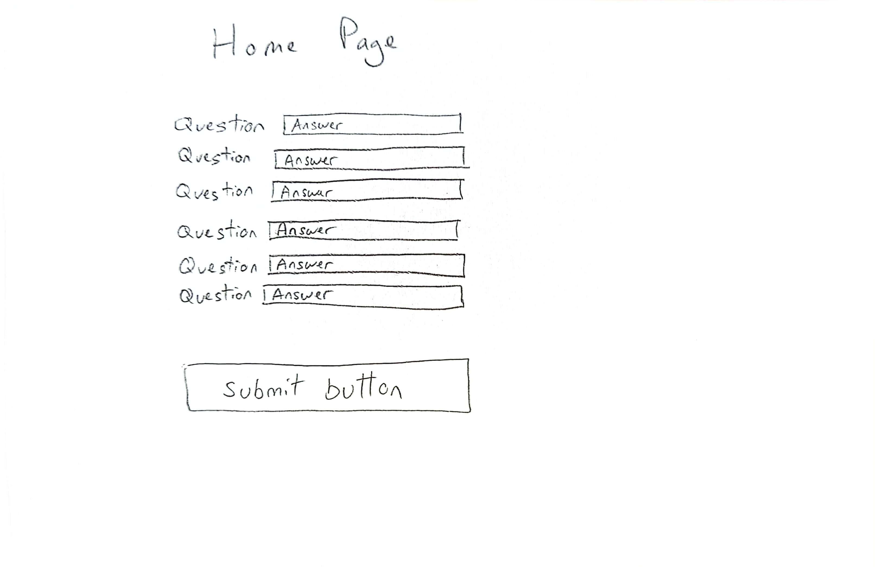
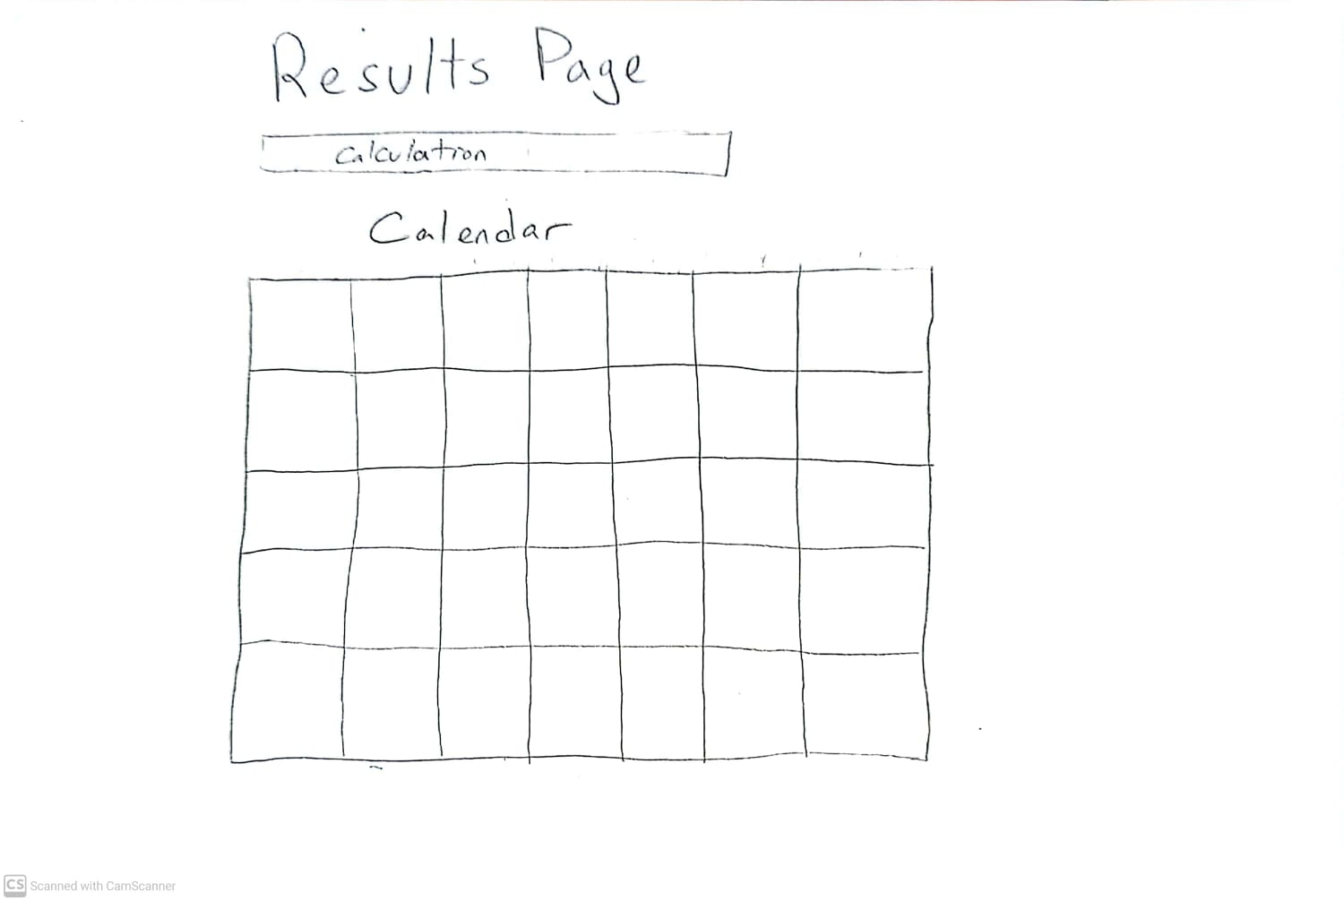
Sketch

Slide 6
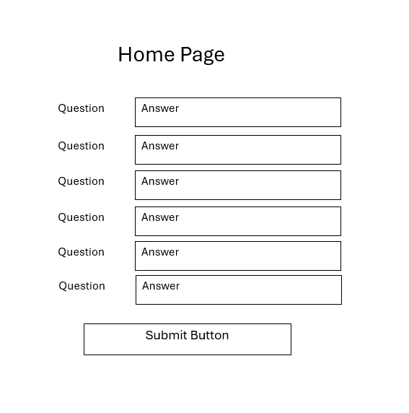
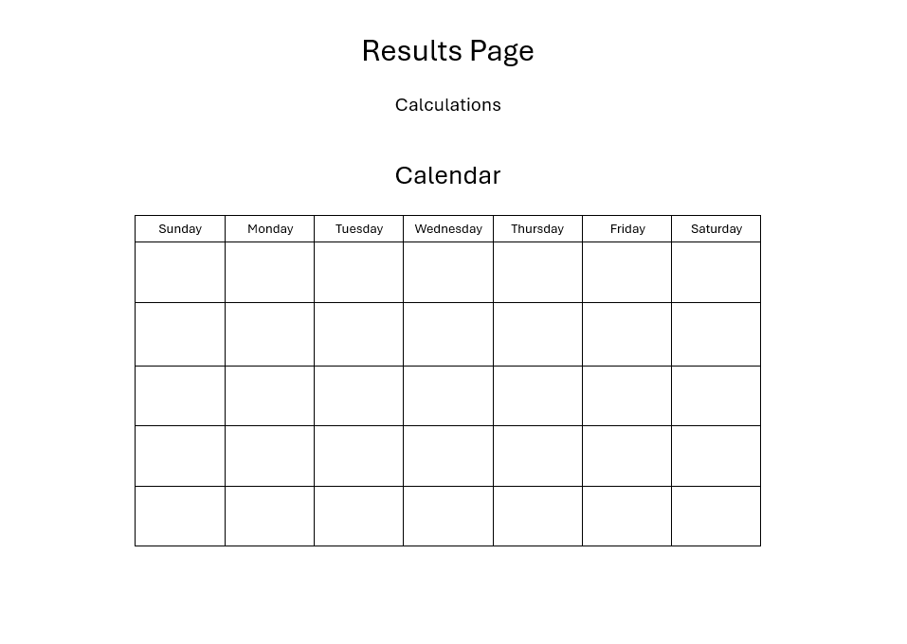
Wireframe

Slide 7
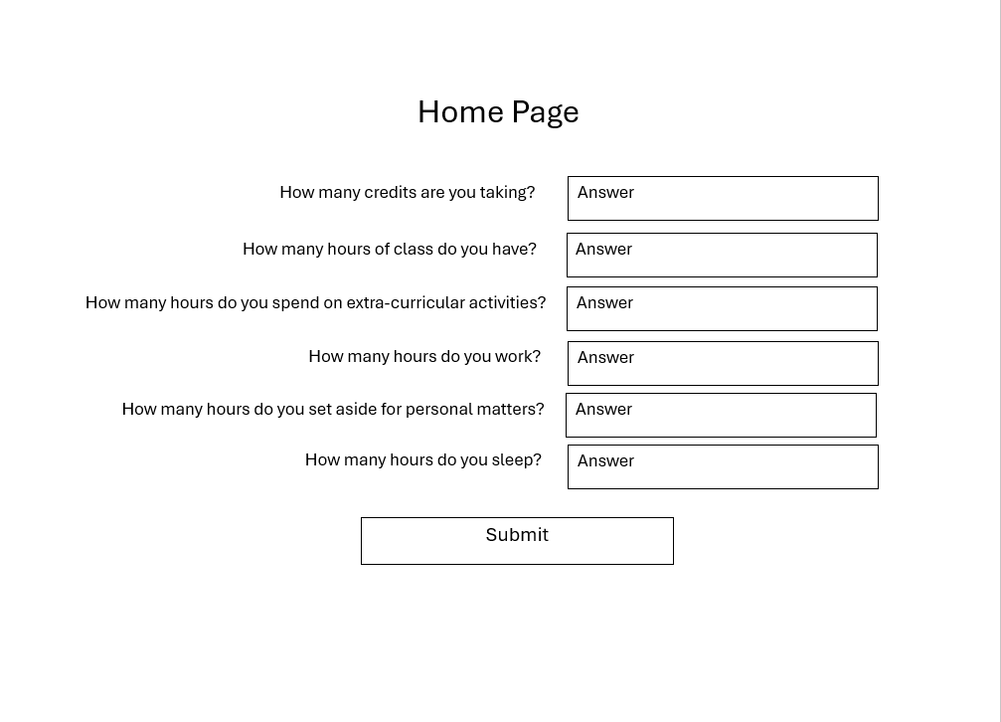
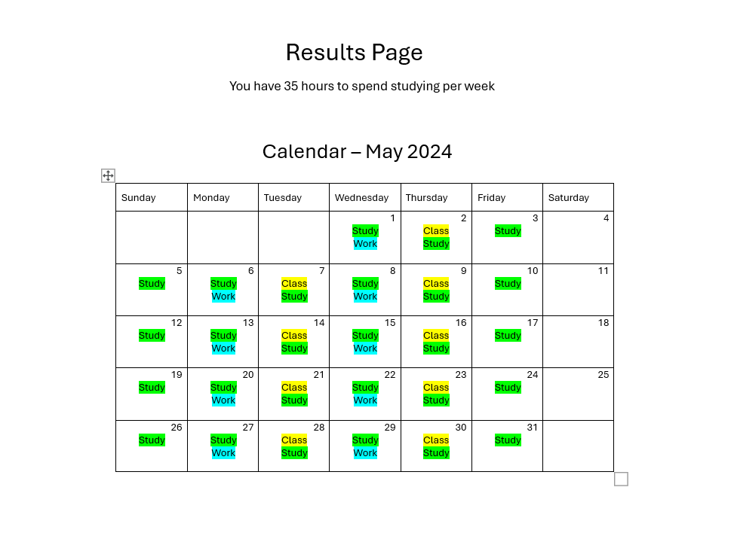
Mockup

Slide 8
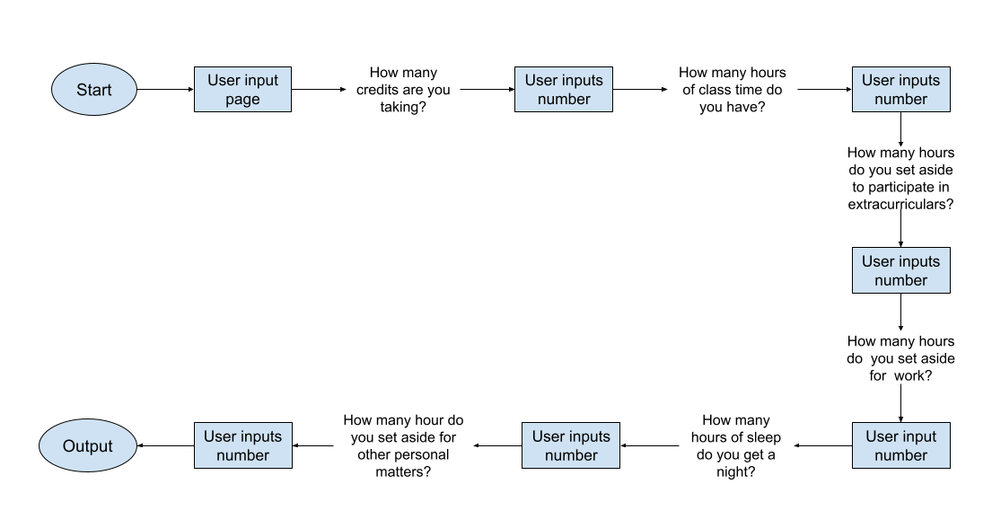
User Flow Diagram
Originally, we had planned on having a login page and to have trackers, so this page was more intricate. Also, we had made certain questions yes or no and based on your response you might have been asked additional questions, e.g., You would be asked if you worked. If you answered yes, you would then be asked how many hours. The user would also have been able to schedule study time on a calendar connected to Google Calendar based on the resulted output.

Slide 9
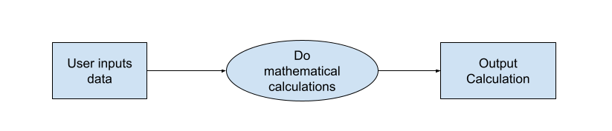
Data Flow Diagram
The user will input data as integers or doubles. These will be used for the calculations which will calculate the amount of time already allocated for activities and will output the remaining time they have to allocate towards schoolwork.
Originally, we were going to store the data and then do calculations based on the stored data. We were going to have trackers as well.

Slide 10
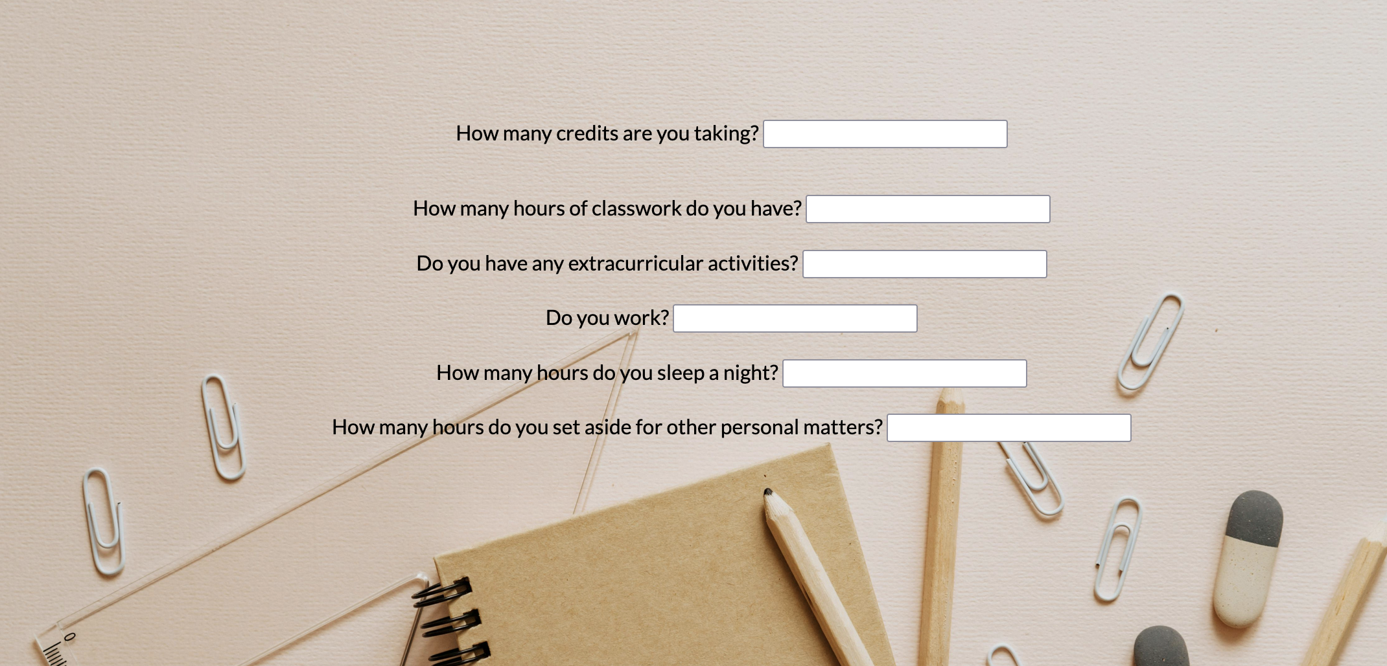
Initial User Interface
This was our basic prototype. We had boxes with fill-in. If you answered yes to the yes or no questions additional questions popped up asking how many hours. Based on the user input, the calculation with the number of hours they had to allocated towards studying would pop up at the bottom.

Slide 11
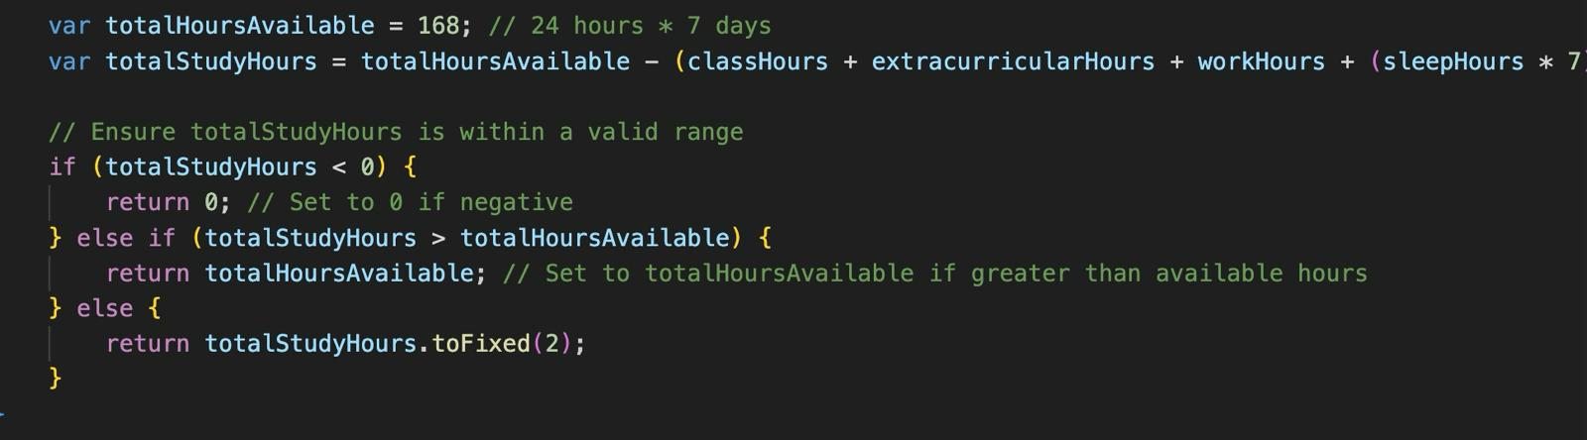
Calculations
Here is the code to calculate the amount of time free to allocate towards studying. It is calculated by subtracting the number of hours inputted by the user for each question; the hours you sleep a night is multiplied by 7 and that total is subtracted from the number of unallocated hours.

Slide 12
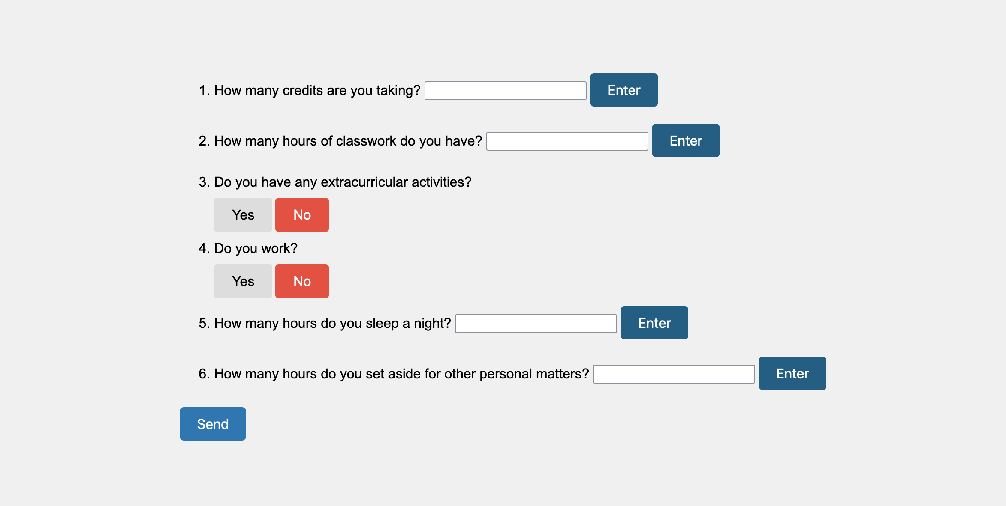
Intermittent User Interface 1
This was the next version we produced. We were experimenting with different formatting. We added toggle buttons so if you had selected yes, another question would appear. We also added a send/submit button, but we hadn’t gotten up to making the results page yet.

Slide 13
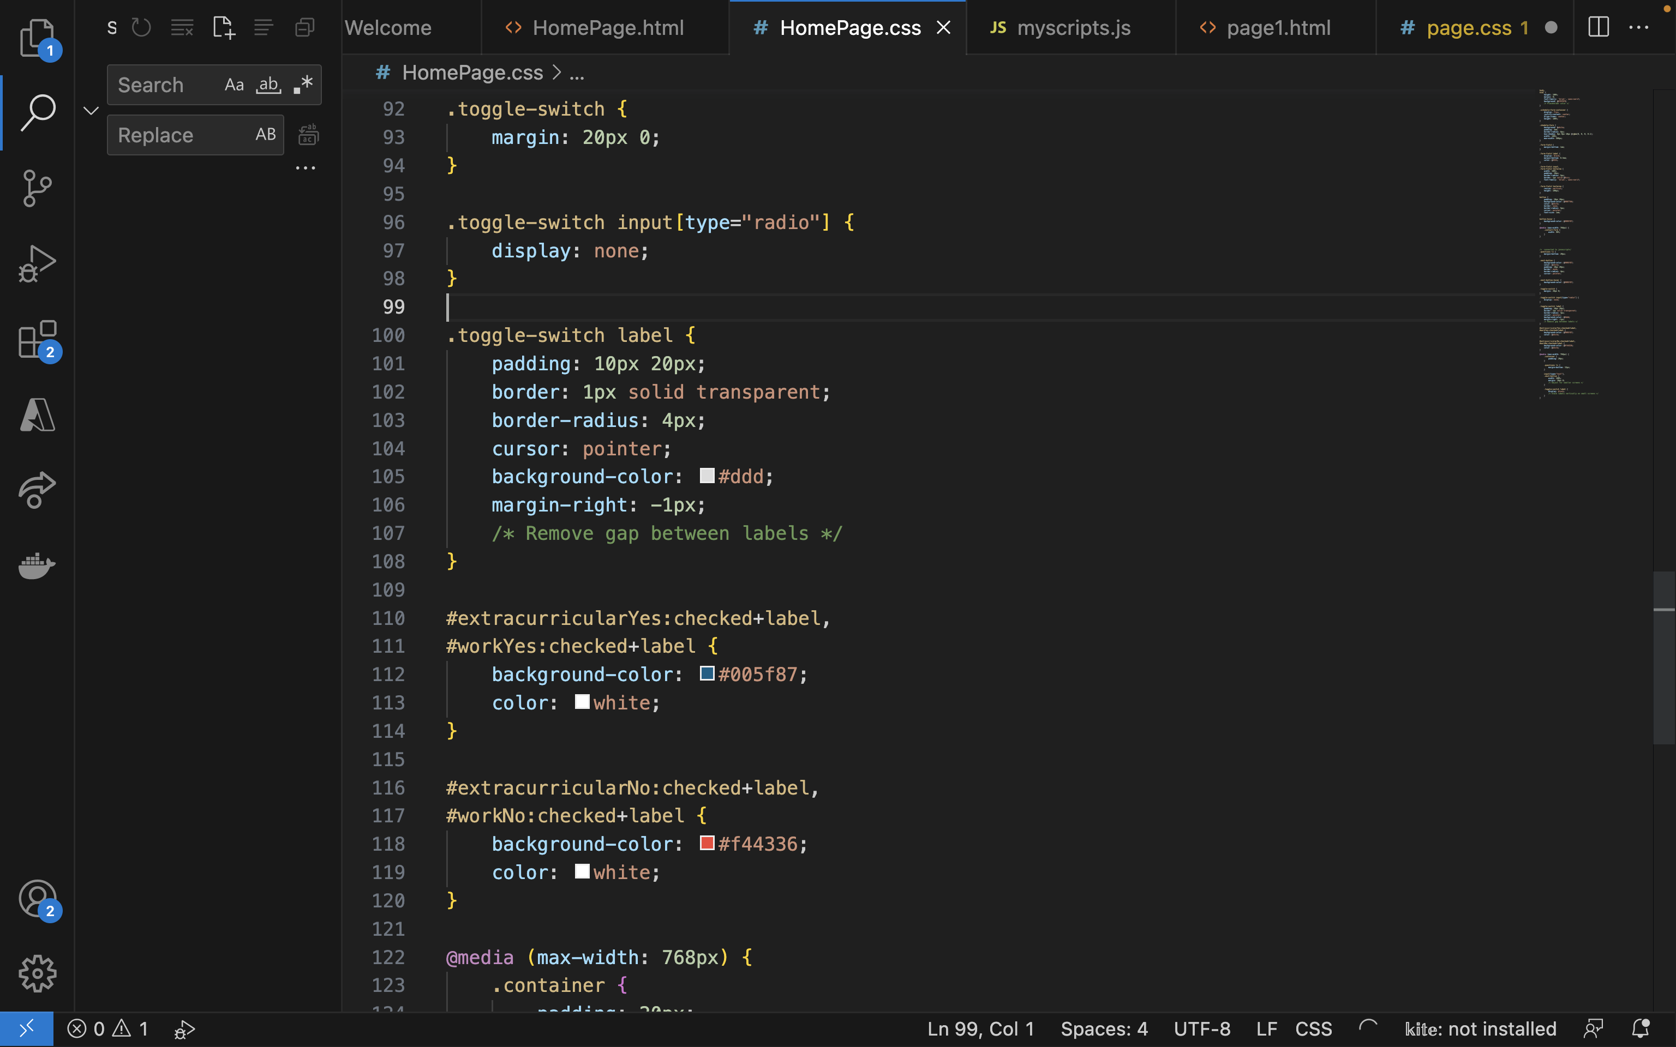
Toggle Buttons
We had added a toggle button for the yes or no questions to make them more interactive. If the user selected yes, an addition question would appear. We ultimately removed them from the project and just changed the way the questions are asked because the additional questions appearing did not look good. But we included this because was a part of the code that was tricky and that we spent time figuring out.

Slide 14
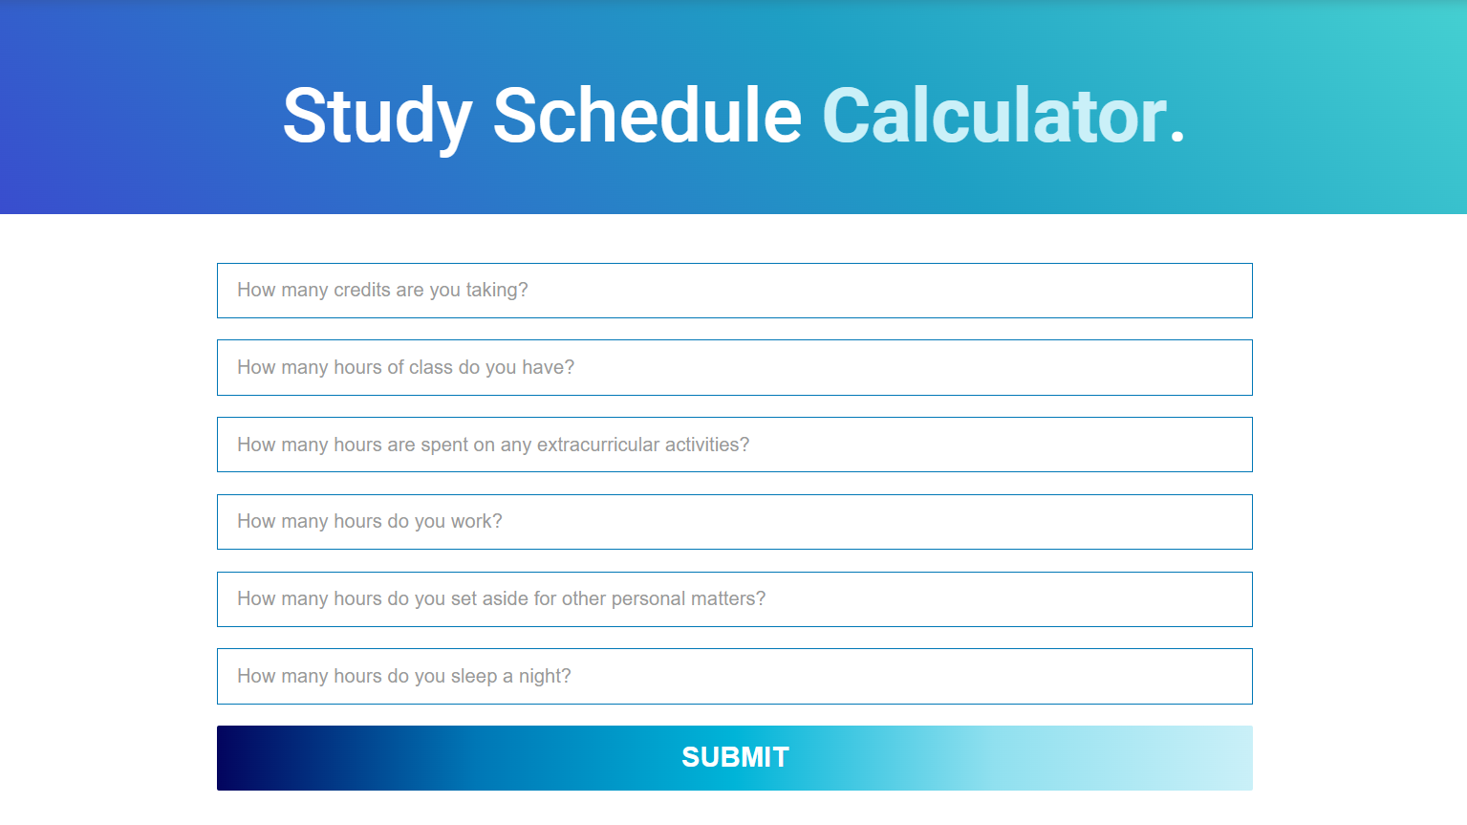
Intermittent User Interface 2
We added a header, removed the toggle button, added a color scheme and changed the formatting to be more visually pleasing. We also created a results page that is connected to the submit button.

Slide 15
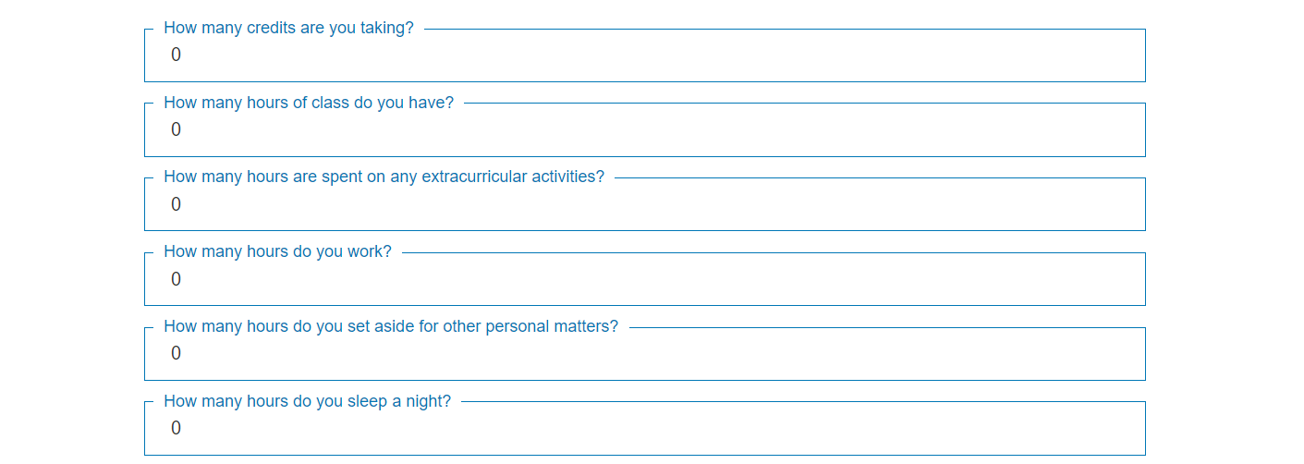
UX/UI Design
We chose to use a blue color pallet because blue is a calming color that is associated with tranquility and stability and is well liked by both men and women. Psychologist Stephen E. Palmer said, “It turns out, if you look at all the things that are associated with blue, they’re mostly positive. It’s really hard to think of negative blue things.” For this reason, many large, successful companies use blue as their theme color including, Facebook, LinkedIn, Walmart, Intel, and Skype. We figured it makes sense to use a calming color because this is meant for students and students tend to be stressed especially about studying.
When also changed the formatting so when you enter an answer in the box, the question jumps to be in place of the top line. We felt that this was a much cleaner and visually appealing look.

Slide 16
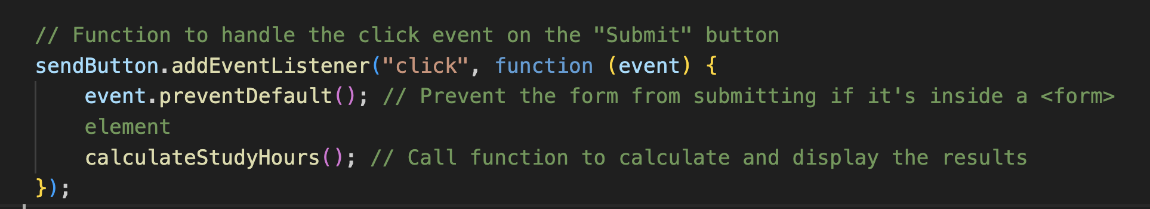
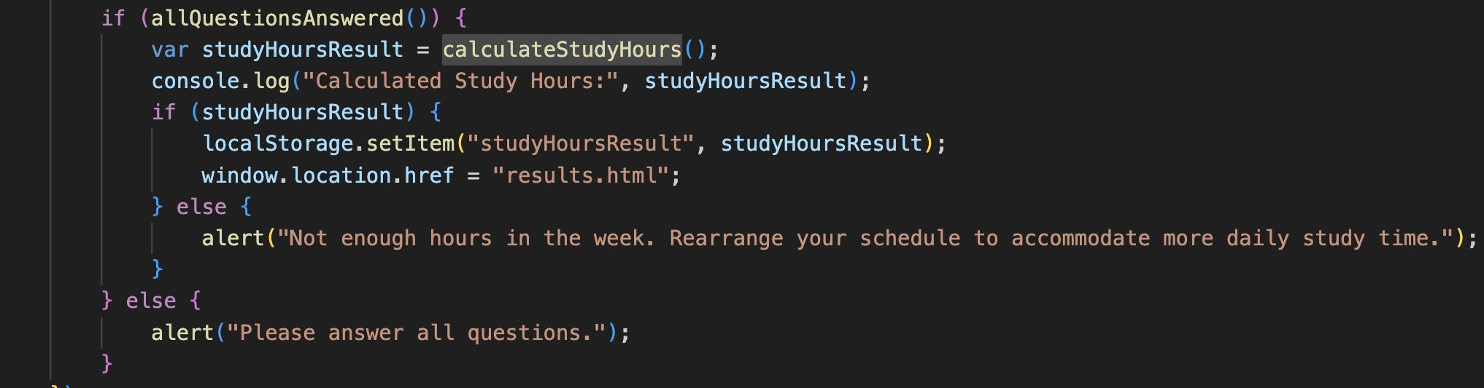
UX/UI Design
We have a submit button at the bottom of the page which leads you to the results page. The results page will be useful for outputting a calendar which is the next part of the project.
We also added error messages that will not allow someone to submit the form if they did not fill out all the questions or they have more hours listed than are possible in a week.

Slide 17
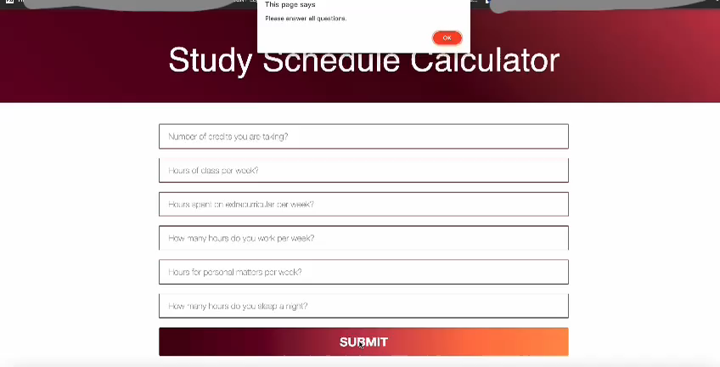

Slide 18
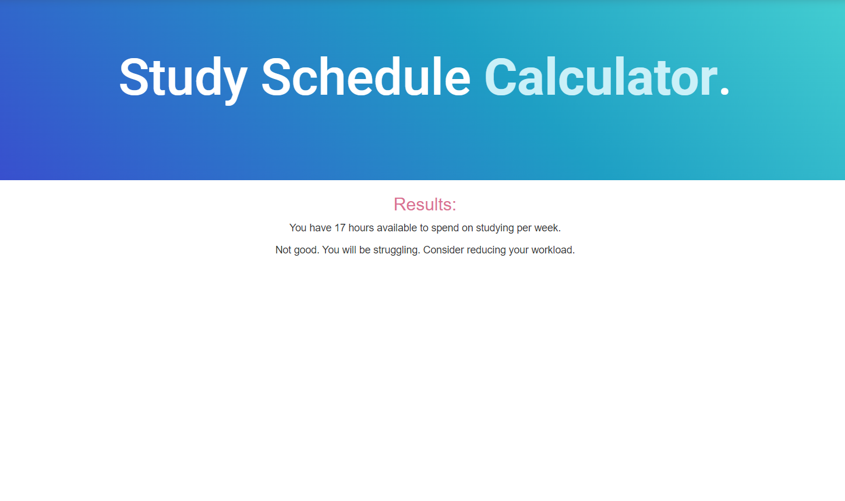
Initial Results Page
This is the page where we display the results. It will tell you the number of hours you have that are available for studying. There is also a message based on how much time you have. For example, if you have 100 hours a week that you can allocate towards schoolwork, it will display “You are good with timing”. If you have 15 hours a week that you can allocate towards schoolwork it will display a message along the lines of “You might not have enough time in your week. You may need to reprioritize your time.” The remaining space below is for where the calendar should appear.

Slide 19
User Feedback
At this point we had a working model to test. We sent the calculator out to student with a survey to fill out to give their feedback.
The feedback we got was highly positive:
94.2% said that the study time calculator was easy to navigate.
88.8% said that the user interface was intuitive and user-friendly.
82.4% said they are likely to use this tool in the future.
Most people said that they would recommend this to a friend.

Slide 20
User Feedback
Critics for improvement were:
Adding some basic directions at the top
Add a per week to each of the applicable question applicable
The alignment doesn’t work well on mobile devices
Updates based in the critics:
We added the per week to the applicable questions. This also helped with the clarity that directions would provide.
We changed the questions so they will look good on mobile devices as well as on the computer.

Slide 21
User Feedback - Usefulness
When asked if you would recommend it to a friend? Why or why not?
“Yes it’ll make it easier to schedule things.”
“Sure, it helps keep in perspective how much we actually have.”
“Yes, because all of my friends could use this calculator tool.”
“Yeah it’s interesting and helps you figure out how much time you have for studying even with the free time you already take for yourself.”
“Yes because I think it is useful to know exactly how much time we should have based on this helpful calculations. This can help with time management and planning out when to get course work done, have free time, do extracurricular activities, and work.”
“Yes I would, I think it’s really helpful to see on paper how much available time you have to study each day. it helps you break up your time easier.”

Slide 22
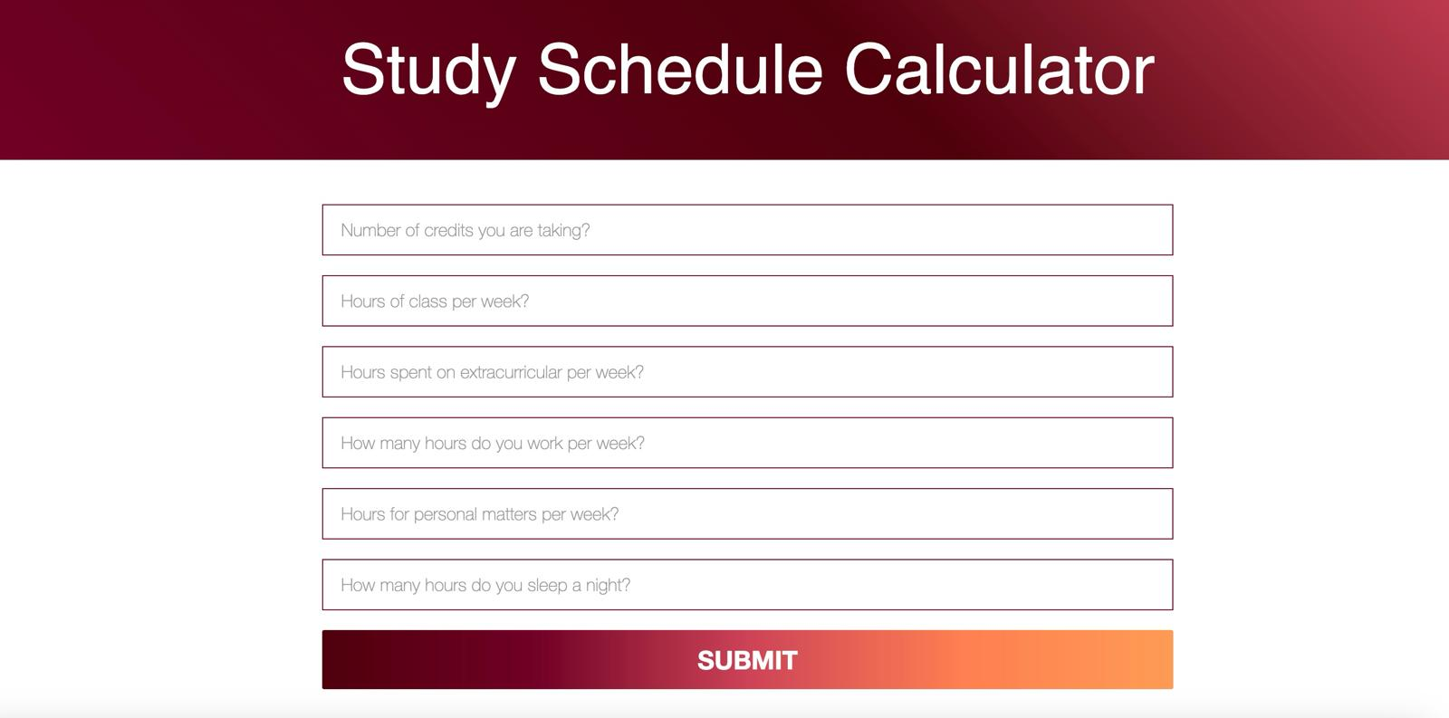
Current User Interface

Slide 23
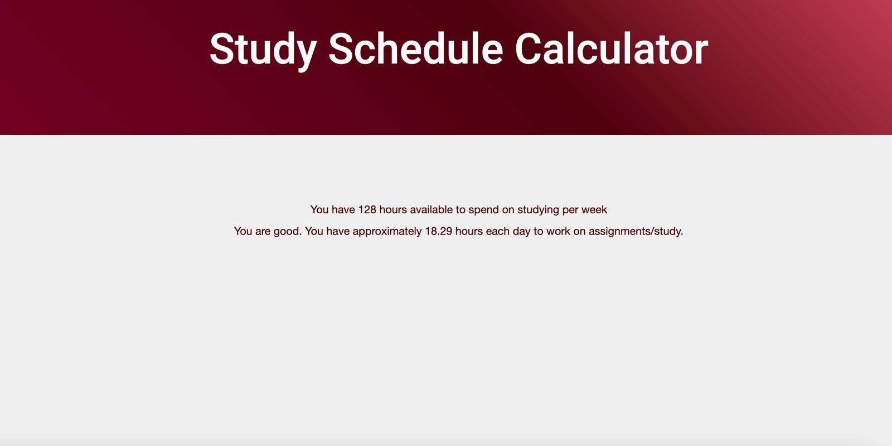
Current Results Page

Slide 24
Updates
We wanted to make our project more Brooklyn College themed as Brooklyn college students are the target users and because we were not able to implement some of the cool add-on features, we had planned to that are Brooklyn College specific due to time constraints. So, we changed the color scheme to make it a variation of maroon and gold which are the school colors.
We also made some changes based on the feedback received from the user research we did.

Slide 25
Use Cases
A freshman student wants to test out possible schedule options and see how the different ones will work with their other obligations and if they will be able to manage their course load. The user must input the necessary data for each variation, and they will receive the different calculations. This can help them figure out what schedule and how large a courseload they can manage.
A student who works a job or has an internship wants to ensure that they will have enough time to complete all their schoolwork for that week. The user inputs the necessary data, and the system will output if they have enough hours in their week. If not, the program will give them an error, informing them that they do not have enough time in their week to accomplish everything they want to, and they will have to re-prioritize.
A senior wants to see if they have the bandwidth to add an independent project/thesis to their schedule on top of their obligations and other classes, if it requires 15 hours a week of work. The user inputs the necessary data, and the system will output if they have enough hours in their week. If not, the program will give them an error message and they will either have to rearrange their schedule or take it a different semester.

Slide 26
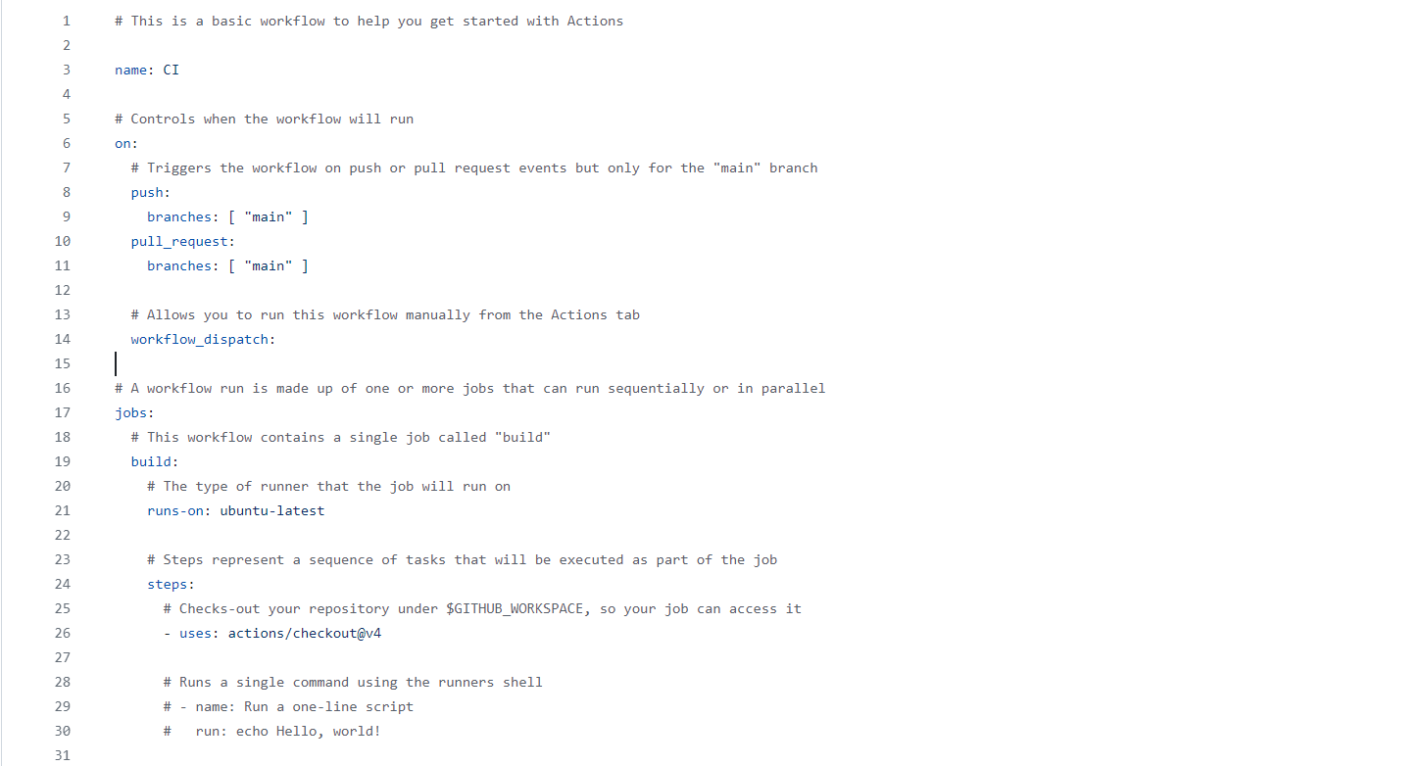
Github Actions
GitHub actions was a challenge we took on. We started a basic CI workflow to get started after learning about the topic. GitHub actions is a continuous integration and deployment, which allows you to automate GitHub repositories, building, and testing.

Slide 27
Next step
We would want to connect to Google Calendar using their API and have that connected to the results page. From there students can schedule study time and have that appear on their phone.
After that we would create a database so we could store data and trackers.
We could then move on to the cool features that make this uniquely helpful for Brooklyn College students. This would include maps of study spaces and their hours as well as vending machines.

Slide 28
Downscoping
We initially had a large scope with lots of cool features, but we had to downscope as we realized we would not be able to complete everything. We started a few weeks late as we were not initially working together and not on this project. Once we were, it took us a bit to figure out how to collaborate smoothly and effectively as a team. We also did not properly anticipate how long it would take us to do things. A lot of the things we did we were unfamiliar with and had to research as we went along.
Because of this, not everything was able to be submitted on time and lots of updates were made. There is an updated version of all of the requirements in the GitHub folder under documentation. (I will include the link on the next page.)

Slide 29
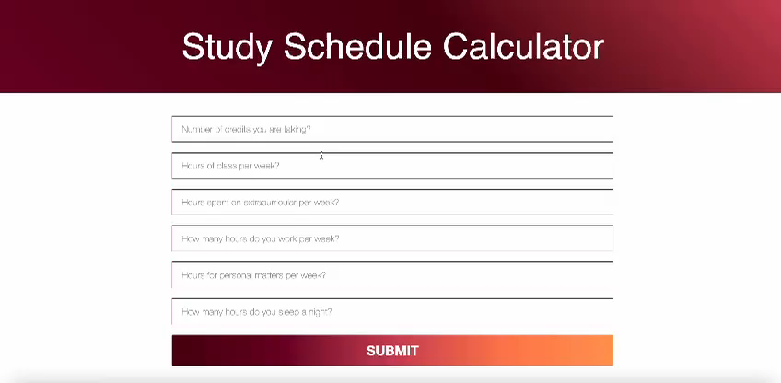

Slide 30
Project Resources
Github: https://github.com/EV778/StudyTimeCalculator
Project Management Board: https://dassie-company.monday.com/boards/6058892207
Documentation: https://github.com/EV778/StudyTimeCalculator/tree/main/Documentation
*We don’t use our project management board much as there are only 2 of us. We mostly split up work and check in on progress through weekly meetings and texts.

